Slide 1
Motorcycle Helmet Customer Segmentation
Objection : provide order information to management so they can deliver more great service.

Slide 2
Original Equipment Manufacturer
An original equipment manufacturer (OEM) traditionally is defined as a company whose goods are used as components in the products of another company, which then sells the finished item to users.
(source: https://www.investopedia.com/terms/o/oem.asp)
PO incoming
Made
PO deliver

Slide 3
Data
Data Frame
Customer
Destination
Model/Type
Helmet Size
Standard
POS Receive Date
POS Delivery Date
XXS
XS (48)
S (50)
M (52)
XS/S
L (54)
XL (56)
XXL
3XL
4XL
S/M
L/XL

Slide 4
EDA and Clustering
Acquired the data
Data Cleaning
Missing values handling
typo
Data Pre-Processing
New Feature: Total Helmet
New Feature: Time Differences
Unsupervised: K-means
Conclusion
Additional empty column
New Feature: Modification

Slide 5
Elbow Method
Compute k means algorithm for different values of k. In this case, varying k from 2 to 10 clusters.
Plot the curve of wss according to the number of clusters k.
The location of a bend (knee) in the plot is generally considered as an indicator of the appropriate number of clusters.
For each k, calculate the total within-cluster sum of square

Slide 6
Silhouette Method
The silhouette analysis estimates the average distance between clusters.
Silhouette Coefficients | Meaning
Near +1 | the sample is far away from the neighboring clusters
Near 0 | the sample is on or very close to the decision boundary between two neighboring clusters
Negative | the samples might have been assigned to the wrong cluster

Slide 7
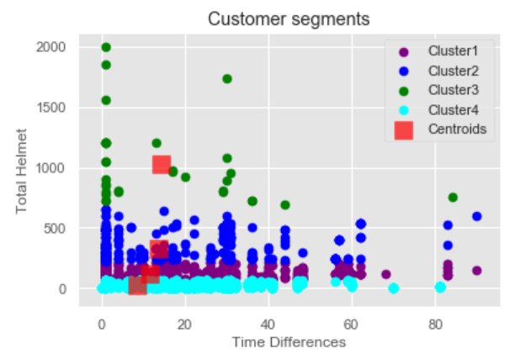
Clustering
Middle-low order: Cluster 1
Low-priority order: Cluster 2
High-Priority order: Cluster 3
Low order: Cluster 4

